Slide 1

PaaS Cloud Goat (hacking custom Salesforce apps)
Rodney Beede
December 2024

Slide 2
About Me
Principal Consultant at Coalfire
Cloud security testing > 10 years
Multiple CVEs discovered
Started as J2EE software developer
M.S. in C.S. - "A Framework for Benevolent Computer Worms" 2012
Coalfire, Rackspace, Seagate, HP, Cisco, RiskMetrics (MSCI)
Presenter at: BSides, InnoTech, Black Hat, Def Con
https://www.rodneybeede.com/curriculum%20vitae/bio.html

Slide 3
Big List of Useful Reference Material
Security Tips for Apex and Visualforce Development
https://developer.salesforce.com/docs/atlas.en-us.apexcode.meta/apexcode/pages_security_tips_intro.htm
Using the with sharing, without sharing, and inherited sharing Keywords
https://developer.salesforce.com/docs/atlas.en-us.apexcode.meta/apexcode/apex_classes_keywords_sharing.htm
Considerations for Sharing and Accessing Contacts
https://help.salesforce.com/s/articleView?id=sf.contacts_sharing_considerations.htm&type=5
Cross Site Scripting (XSS)
https://developer.salesforce.com/docs/atlas.en-us.apexcode.meta/apexcode/pages_security_tips_xss.htm
SOQL SELECT Syntax
https://developer.salesforce.com/docs/atlas.en-us.soql_sosl.meta/soql_sosl/sforce_api_calls_soql_select.htm
Open Redirects
https://developer.salesforce.com/docs/atlas.en-us.packagingGuide.meta/packagingGuide/secure_code_violation_open_redirects.htm
Best Practices for Static Resources
https://developer.salesforce.com/docs/atlas.en-us.pages.meta/pages/pages_compref_additional_page.htm
Salesforce Object Search Language (SOSL)
https://developer.salesforce.com/docs/atlas.en-us.soql_sosl.meta/soql_sosl/sforce_api_calls_sosl.htm
Dynamic SOSL
https://developer.salesforce.com/docs/atlas.en-us.apexcode.meta/apexcode/apex_dynamic_sosl.htm
Regular Expression to Escape SOQL/SOSL Inputs
https://anothersalesforceblog.com/2021/07/01/regular-expression-soql-sosl/
Slightly SOSL'ed: Locating And Testing SOSL Injection - Nick Dunn
https://www.youtube.com/watch?v=VYCy1VXmklw
CSRF Protection Settings
https://help.salesforce.com/s/articleView?id=000387060&type=1&isdtp=p1
Mitigate Cross-Site Request Forgery
https://trailhead.salesforce.com/content/learn/modules/secure-serverside-development/mitigate-crosssite-request-forgery?trail_id=security_developer&isdtp=p1
Cross-Site Request Forgery (CSRF)
https://developer.salesforce.com/docs/atlas.en-us.pages.meta/pages/pages_security_tips_csrf.htm?isdtp=p1
Encrypted Field Security Issue - salesforce.stackexchange.com
Encrypted Field is Masked in a Visualforce Page When Embedded into a Standard Layout
The Top 20 Vulnerabilities Found in the AppExchange Security Review
https://security.salesforce.com/security-advisories

Slide 4
What is a Custom Salesforce App?
Salesforce.com
“Salesforce is cloud-based CRM software” (salesforce.com)
“Build Your Own Salesforce App” (salesforce.com)
Classic apps
Tabs, objects, feeds
Lightning apps
Look and feel customization
Languages
Apex (Java-like)
Visualforce
JavaScript

Slide 5
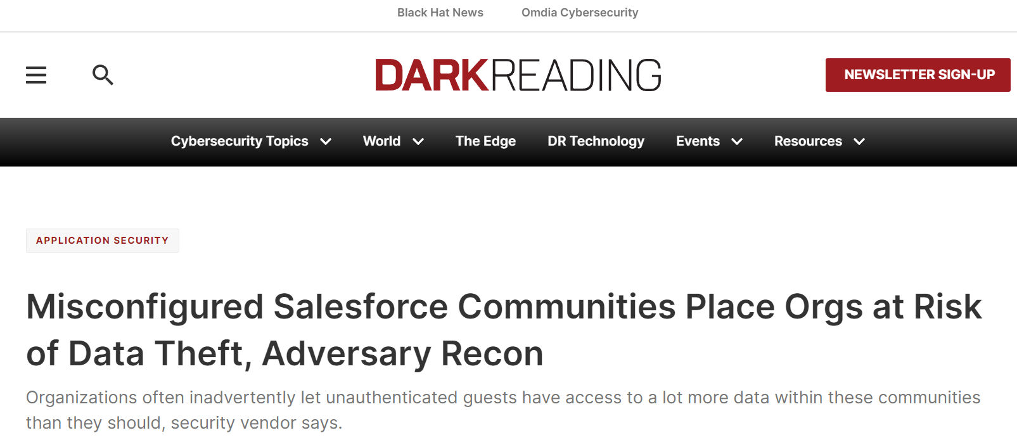
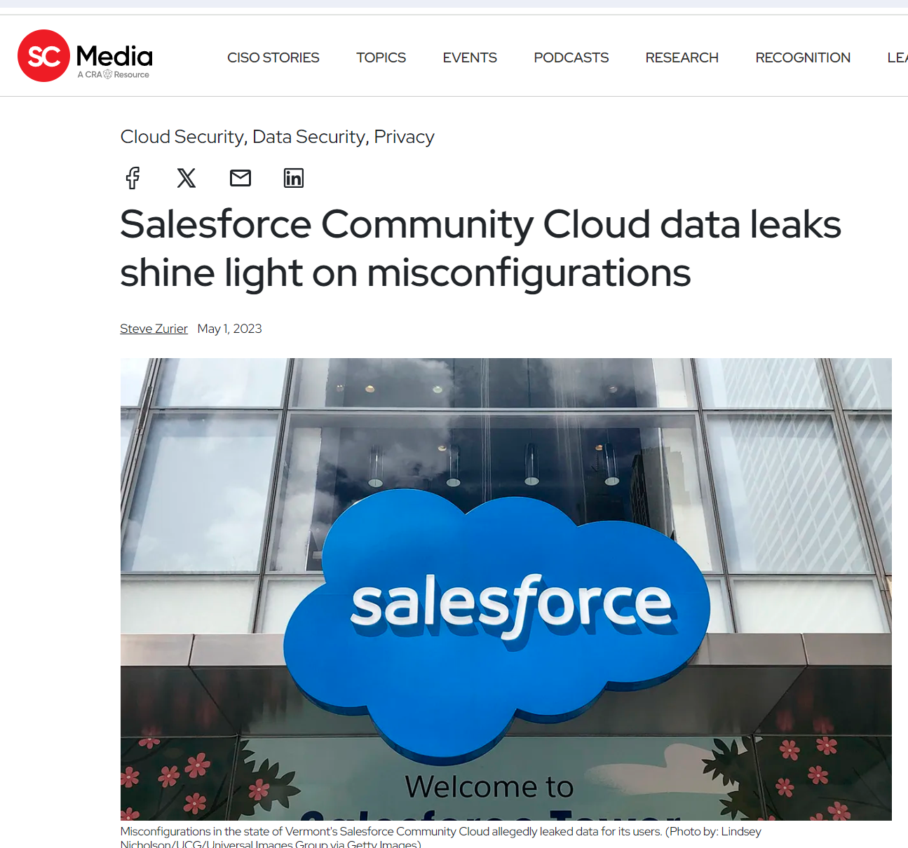
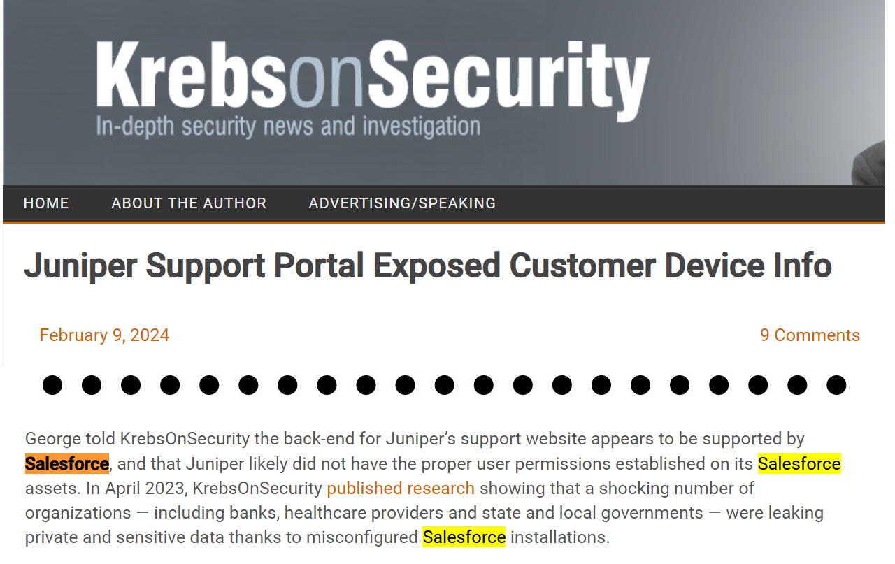
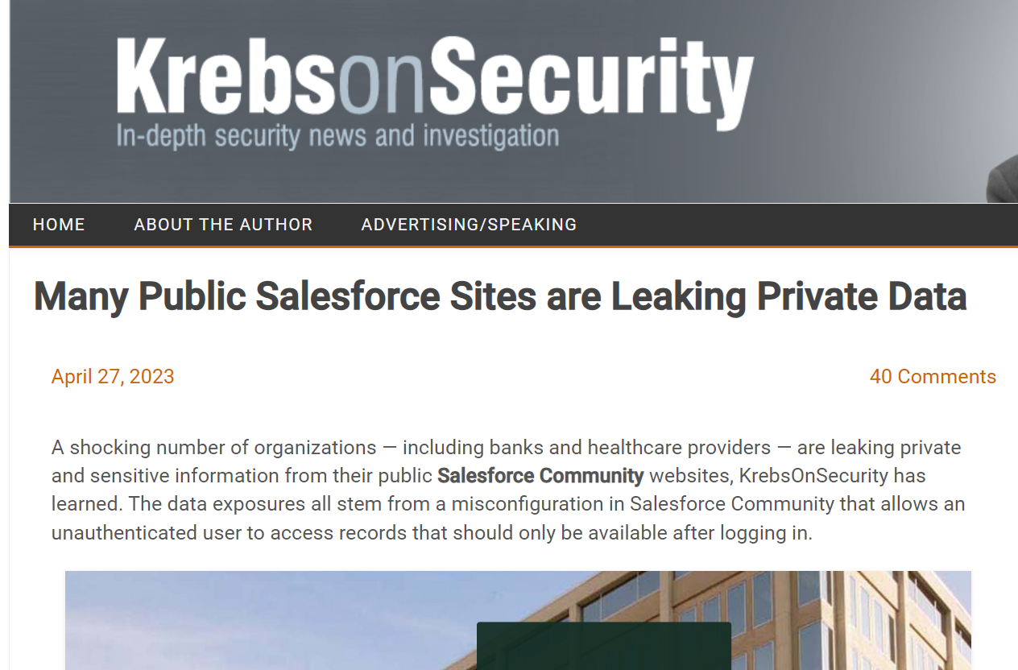
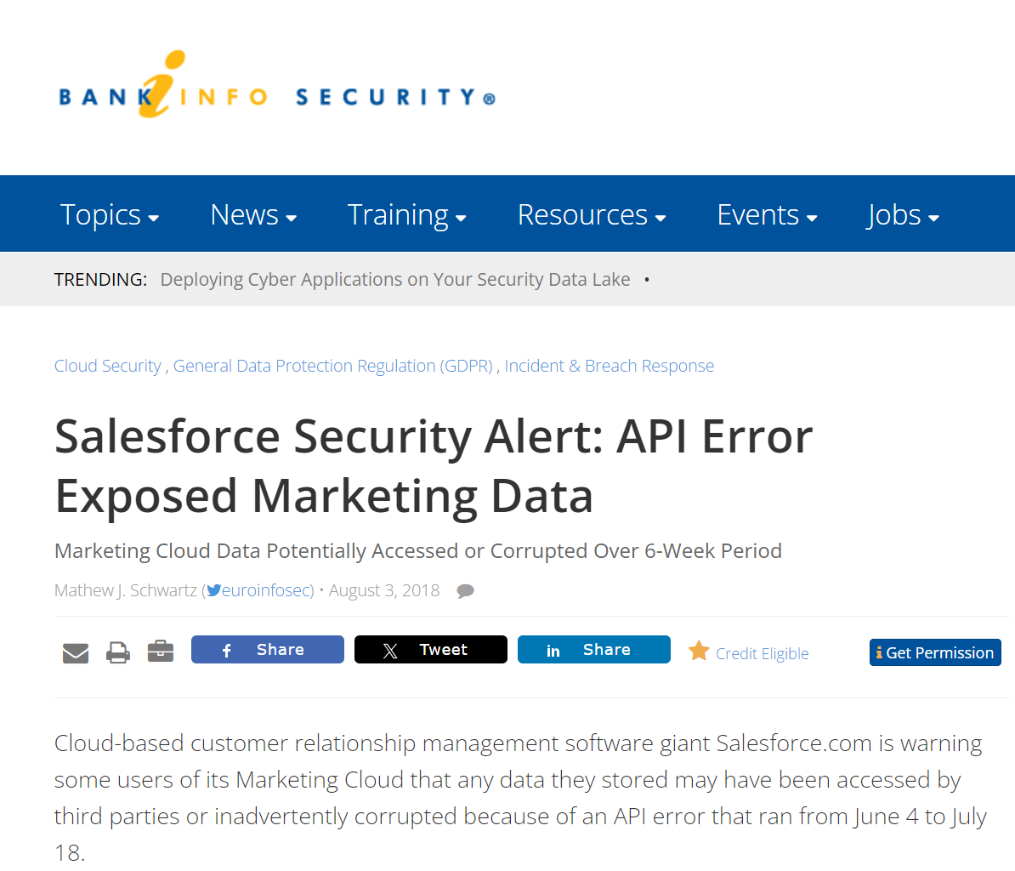
Why Test Custom Salesforce Apps?
https://krebsonsecurity.com/2024/02/juniper-support-portal-exposed-customer-device-info/
https://www.scmagazine.com/news/salesforce-community-cloud-data-leaks-misconfigurations
https://krebsonsecurity.com/2023/04/many-public-salesforce-sites-are-leaking-private-data/
https://www.bankinfosecurity.com/salesforce-security-alert-api-error-exposed-marketing-data-a-11278
https://www.darkreading.com/application-security/misconfigured-salesforce-communities-place-orgs-at-risk-of-data-theft-adversary-recon

Slide 6
What Not to Test
Know the Salesforce policy -https://www.salesforce.com/company/disclosure/
Spam, Brute Force, Denial of Service
Accessing other customers' data
Attacking Salesforce employees (social engr, etc)
Tests against prod accounts
See salesforce.com Vulnerability Reporting Policy

Slide 7
Download PaaS Cloud Goat
https://github.com/Coalfire-Research/paas-cloud-goat
Installation instructions in the repo
Recommend using a Salesforce Developer Edition account

Slide 8
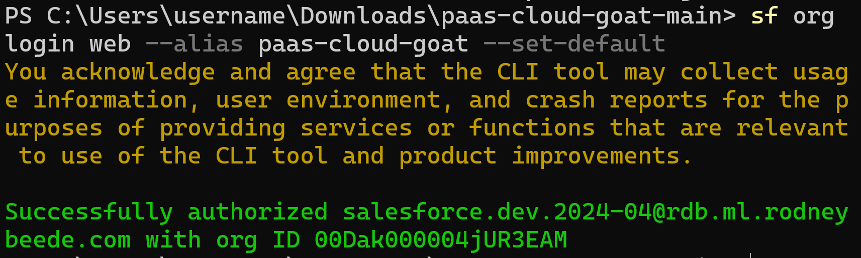
INSTALL.md
sf org login web --alias paas-cloud-goat --set-default

Slide 9
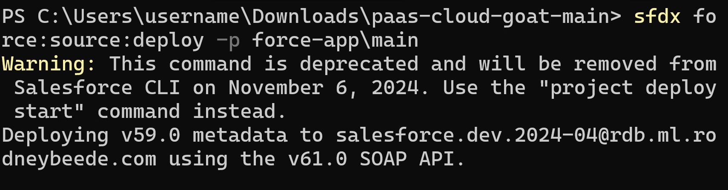
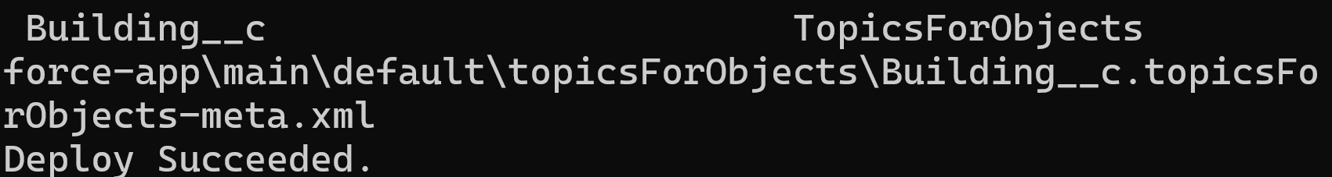
Deploy the App
sfdx force:source:deploy -p force-app\main

Slide 10
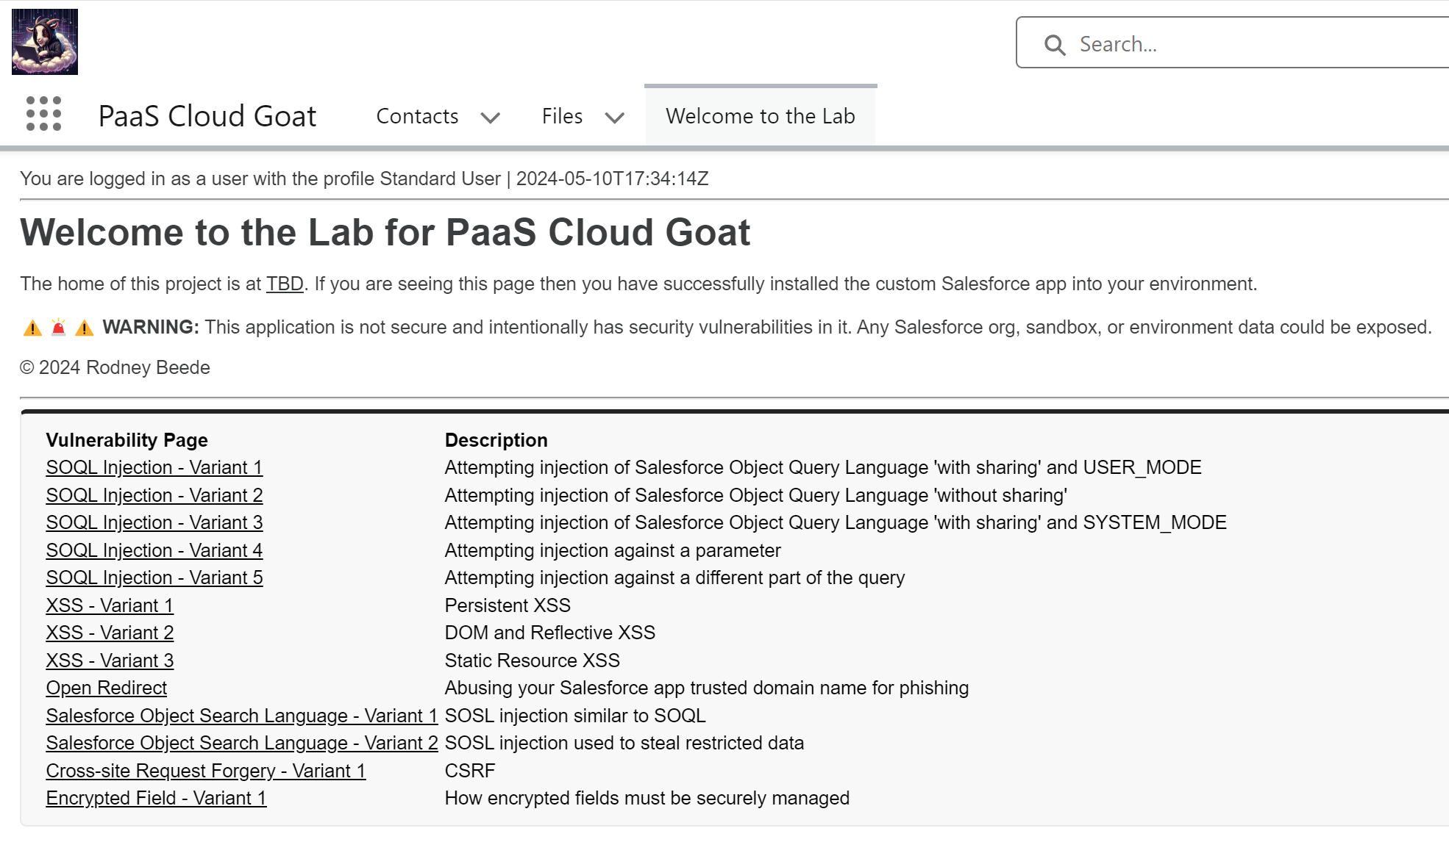

Slide 11
Group Activity
Groups of 2-3
Assigned a vulnerability to exploit
Develop a working proof-of-concept
60 minutes
Present to rest of workshop class at end
Hints
Source code analysis is fair game
Stuck? Answer_Key in the repo

Slide 12
Q&A:

